Slide 1
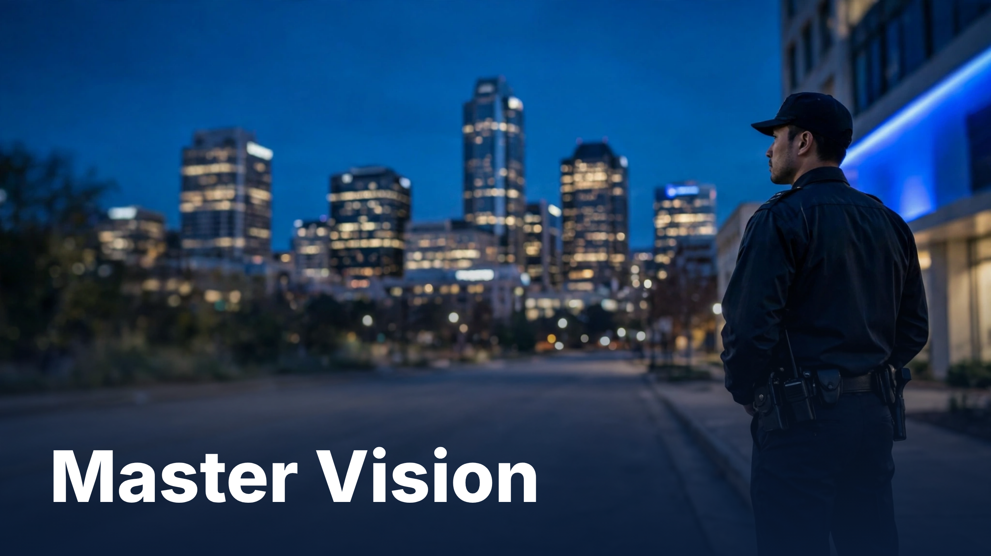
Notes:
Master Vision

Slide 2
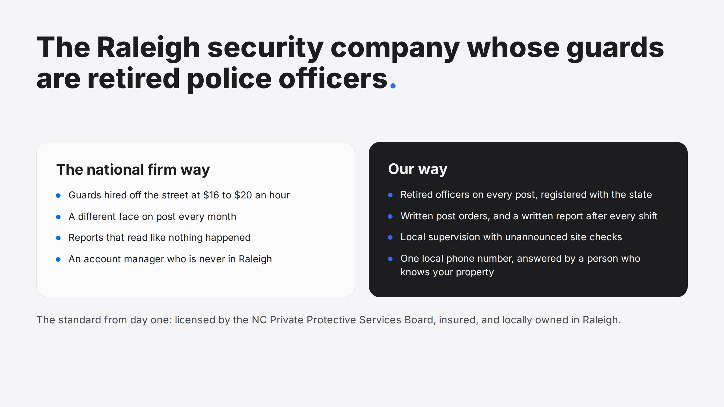
Notes:
The Raleigh security company whose guards are retired police officers.

Slide 3


Slide 4
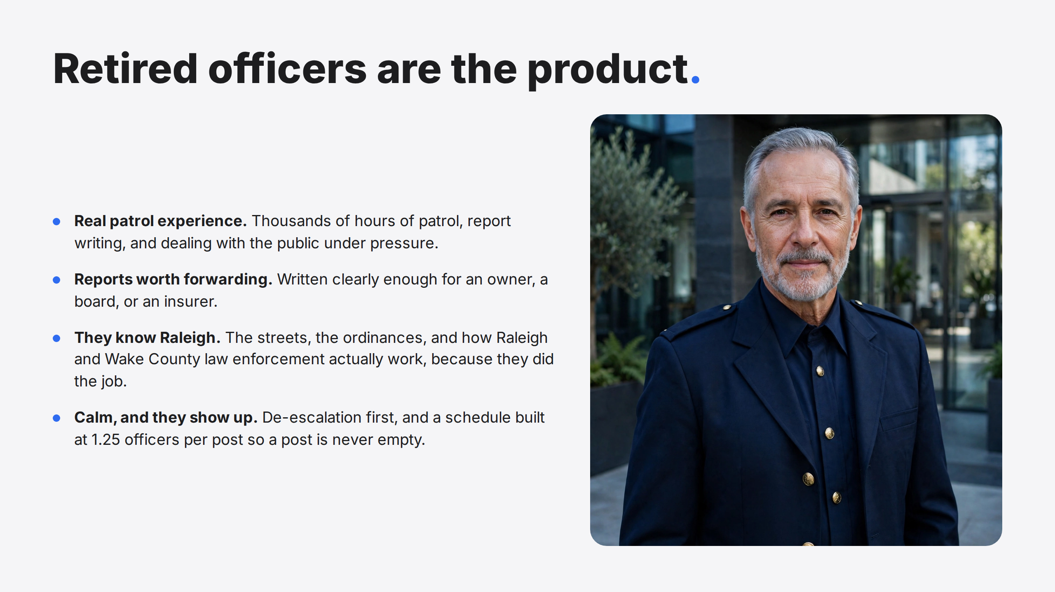
Notes:
Retired officers are the product.

Slide 5
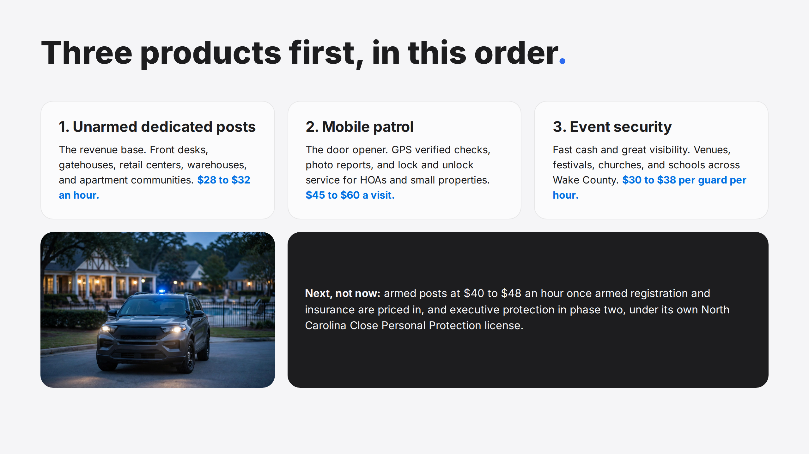
Notes:
Three products first, in this order.

Slide 6
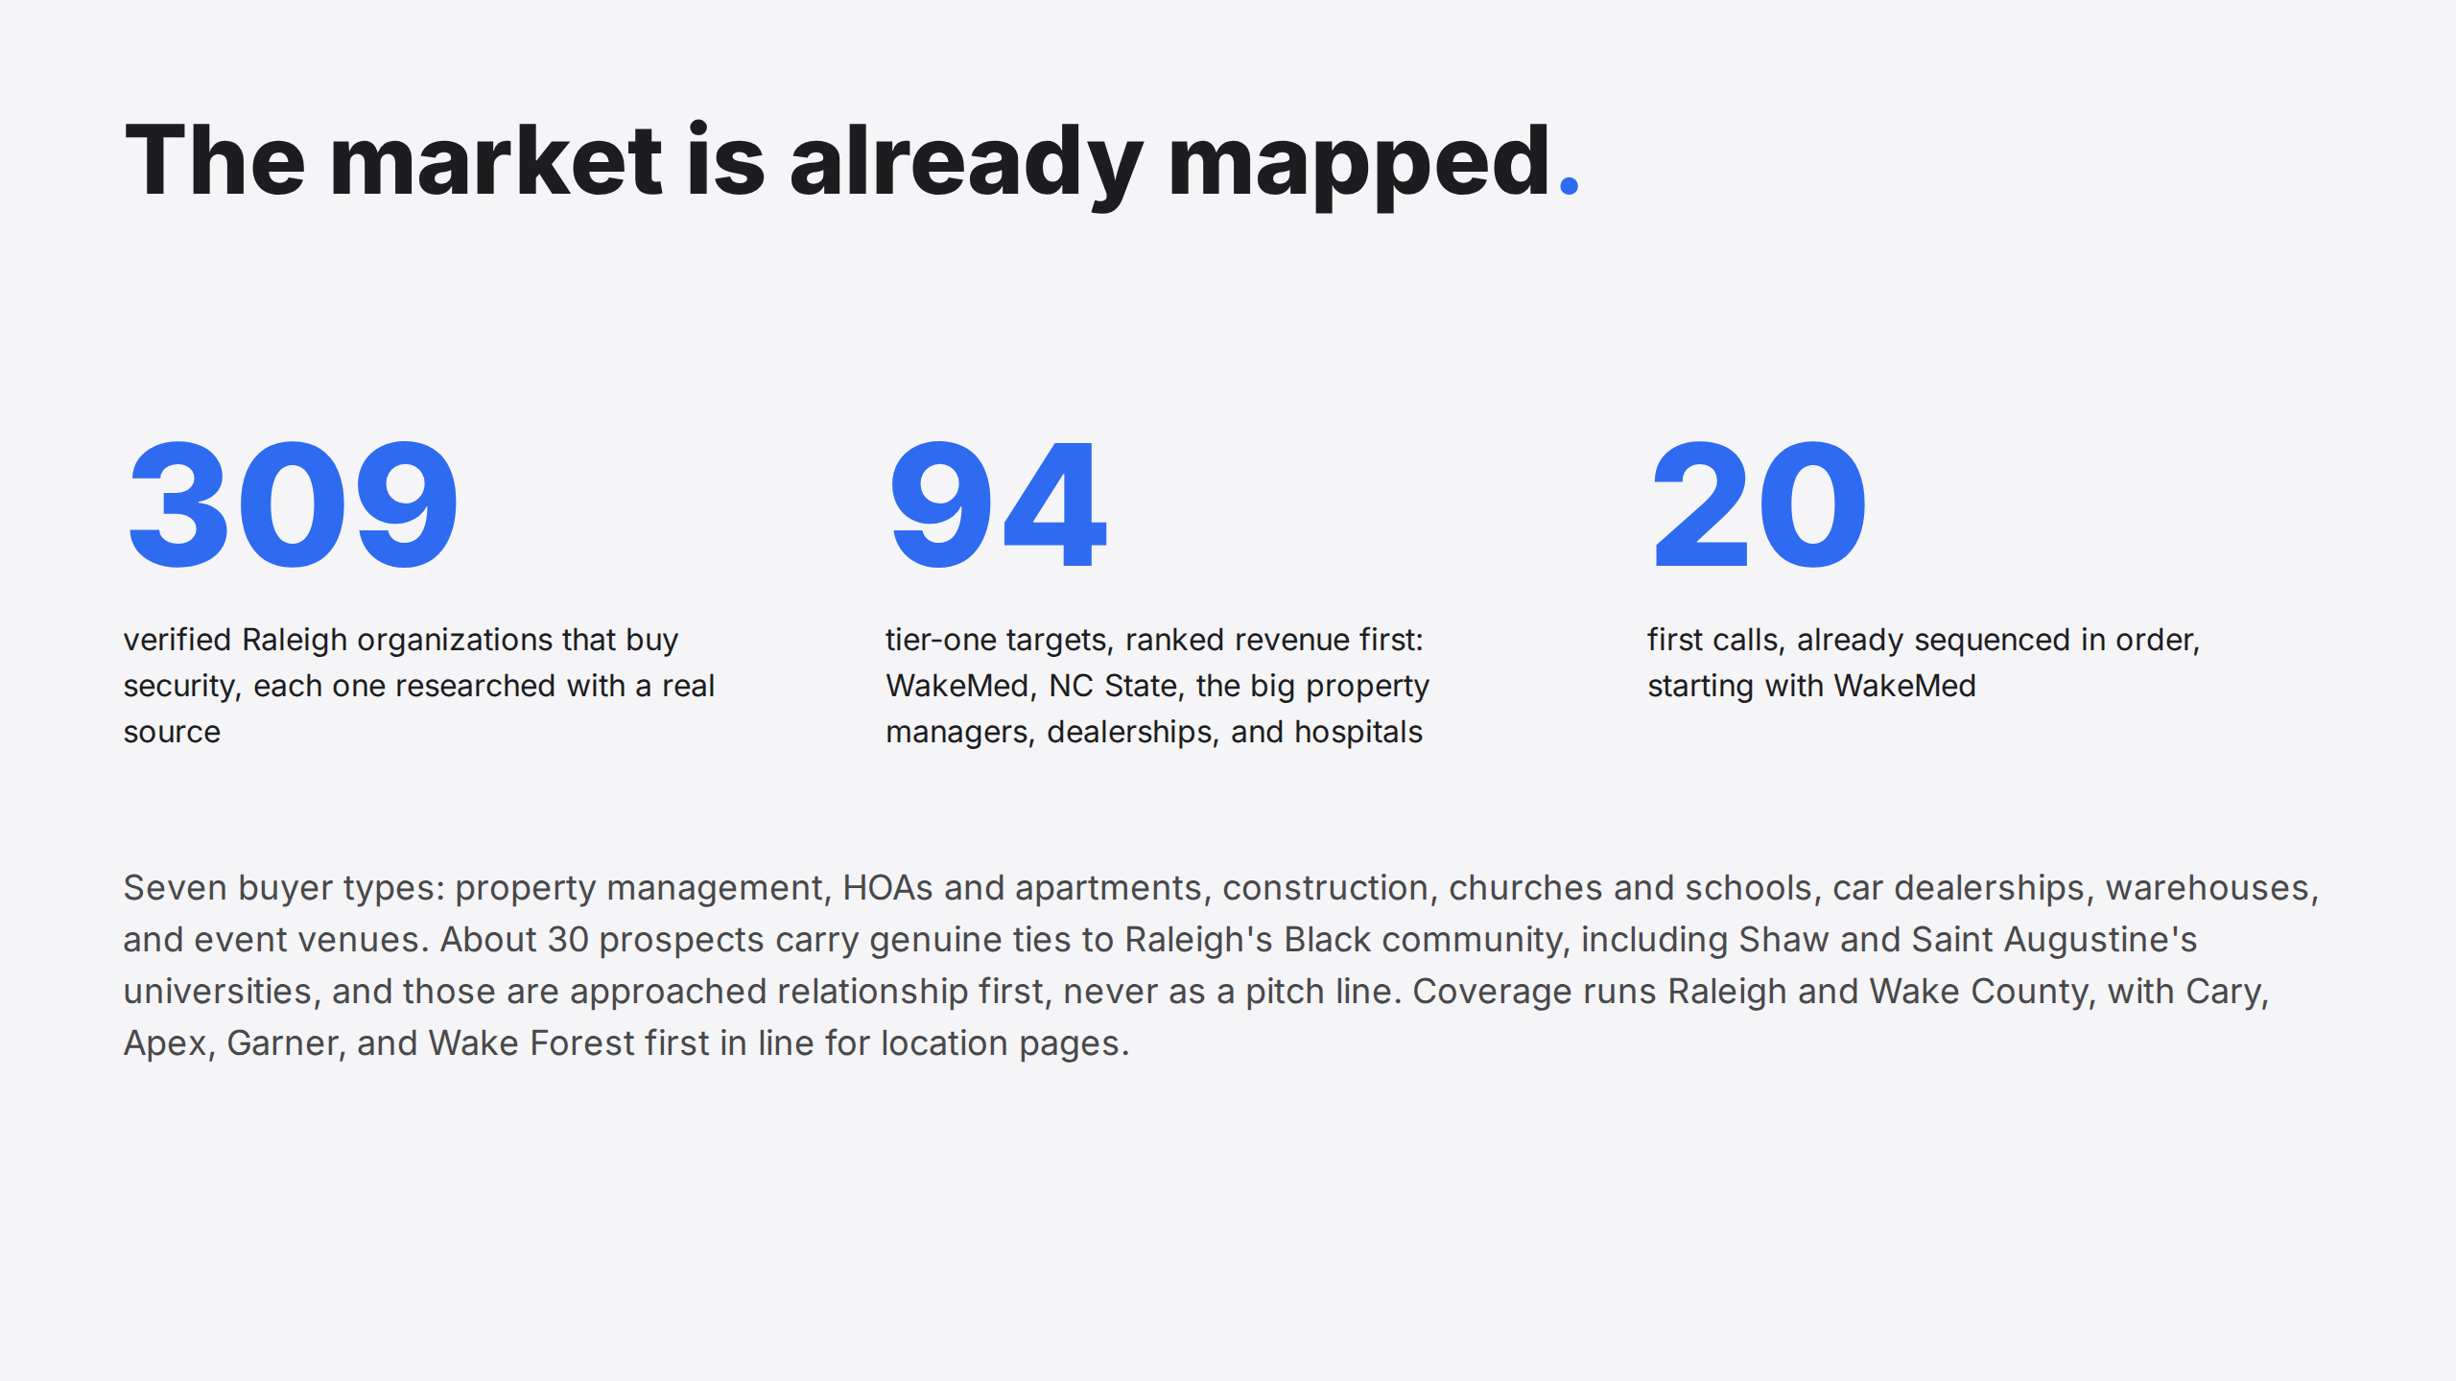
Notes:
The market is already mapped.

Slide 7
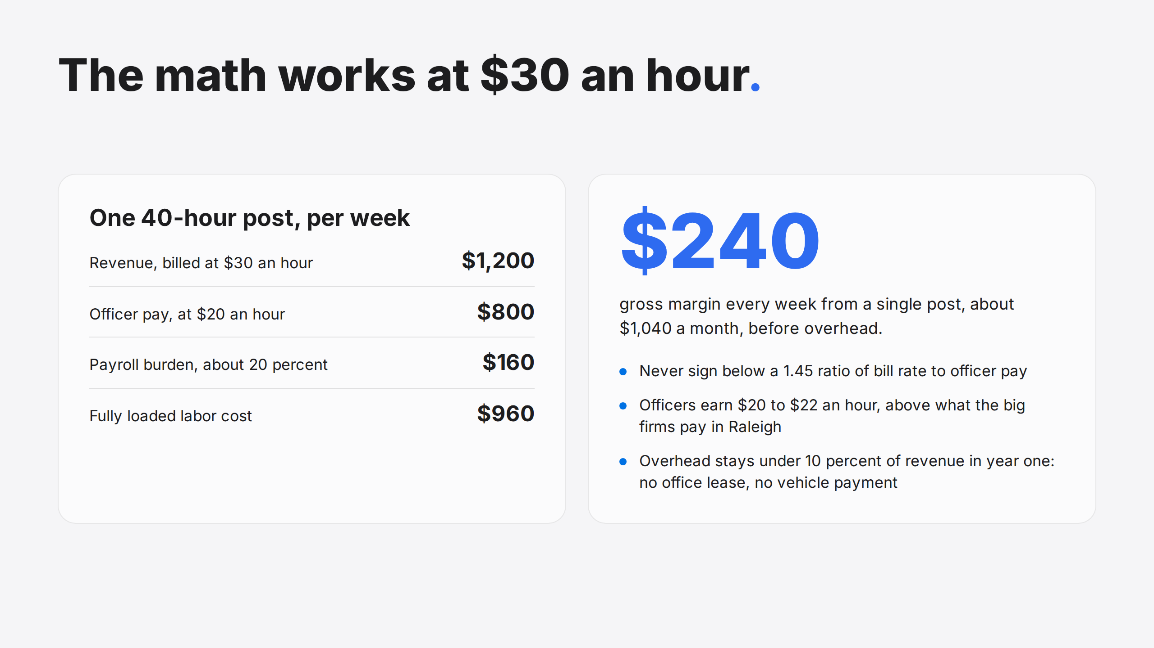
Notes:
The math works at $30 an hour.

Slide 8
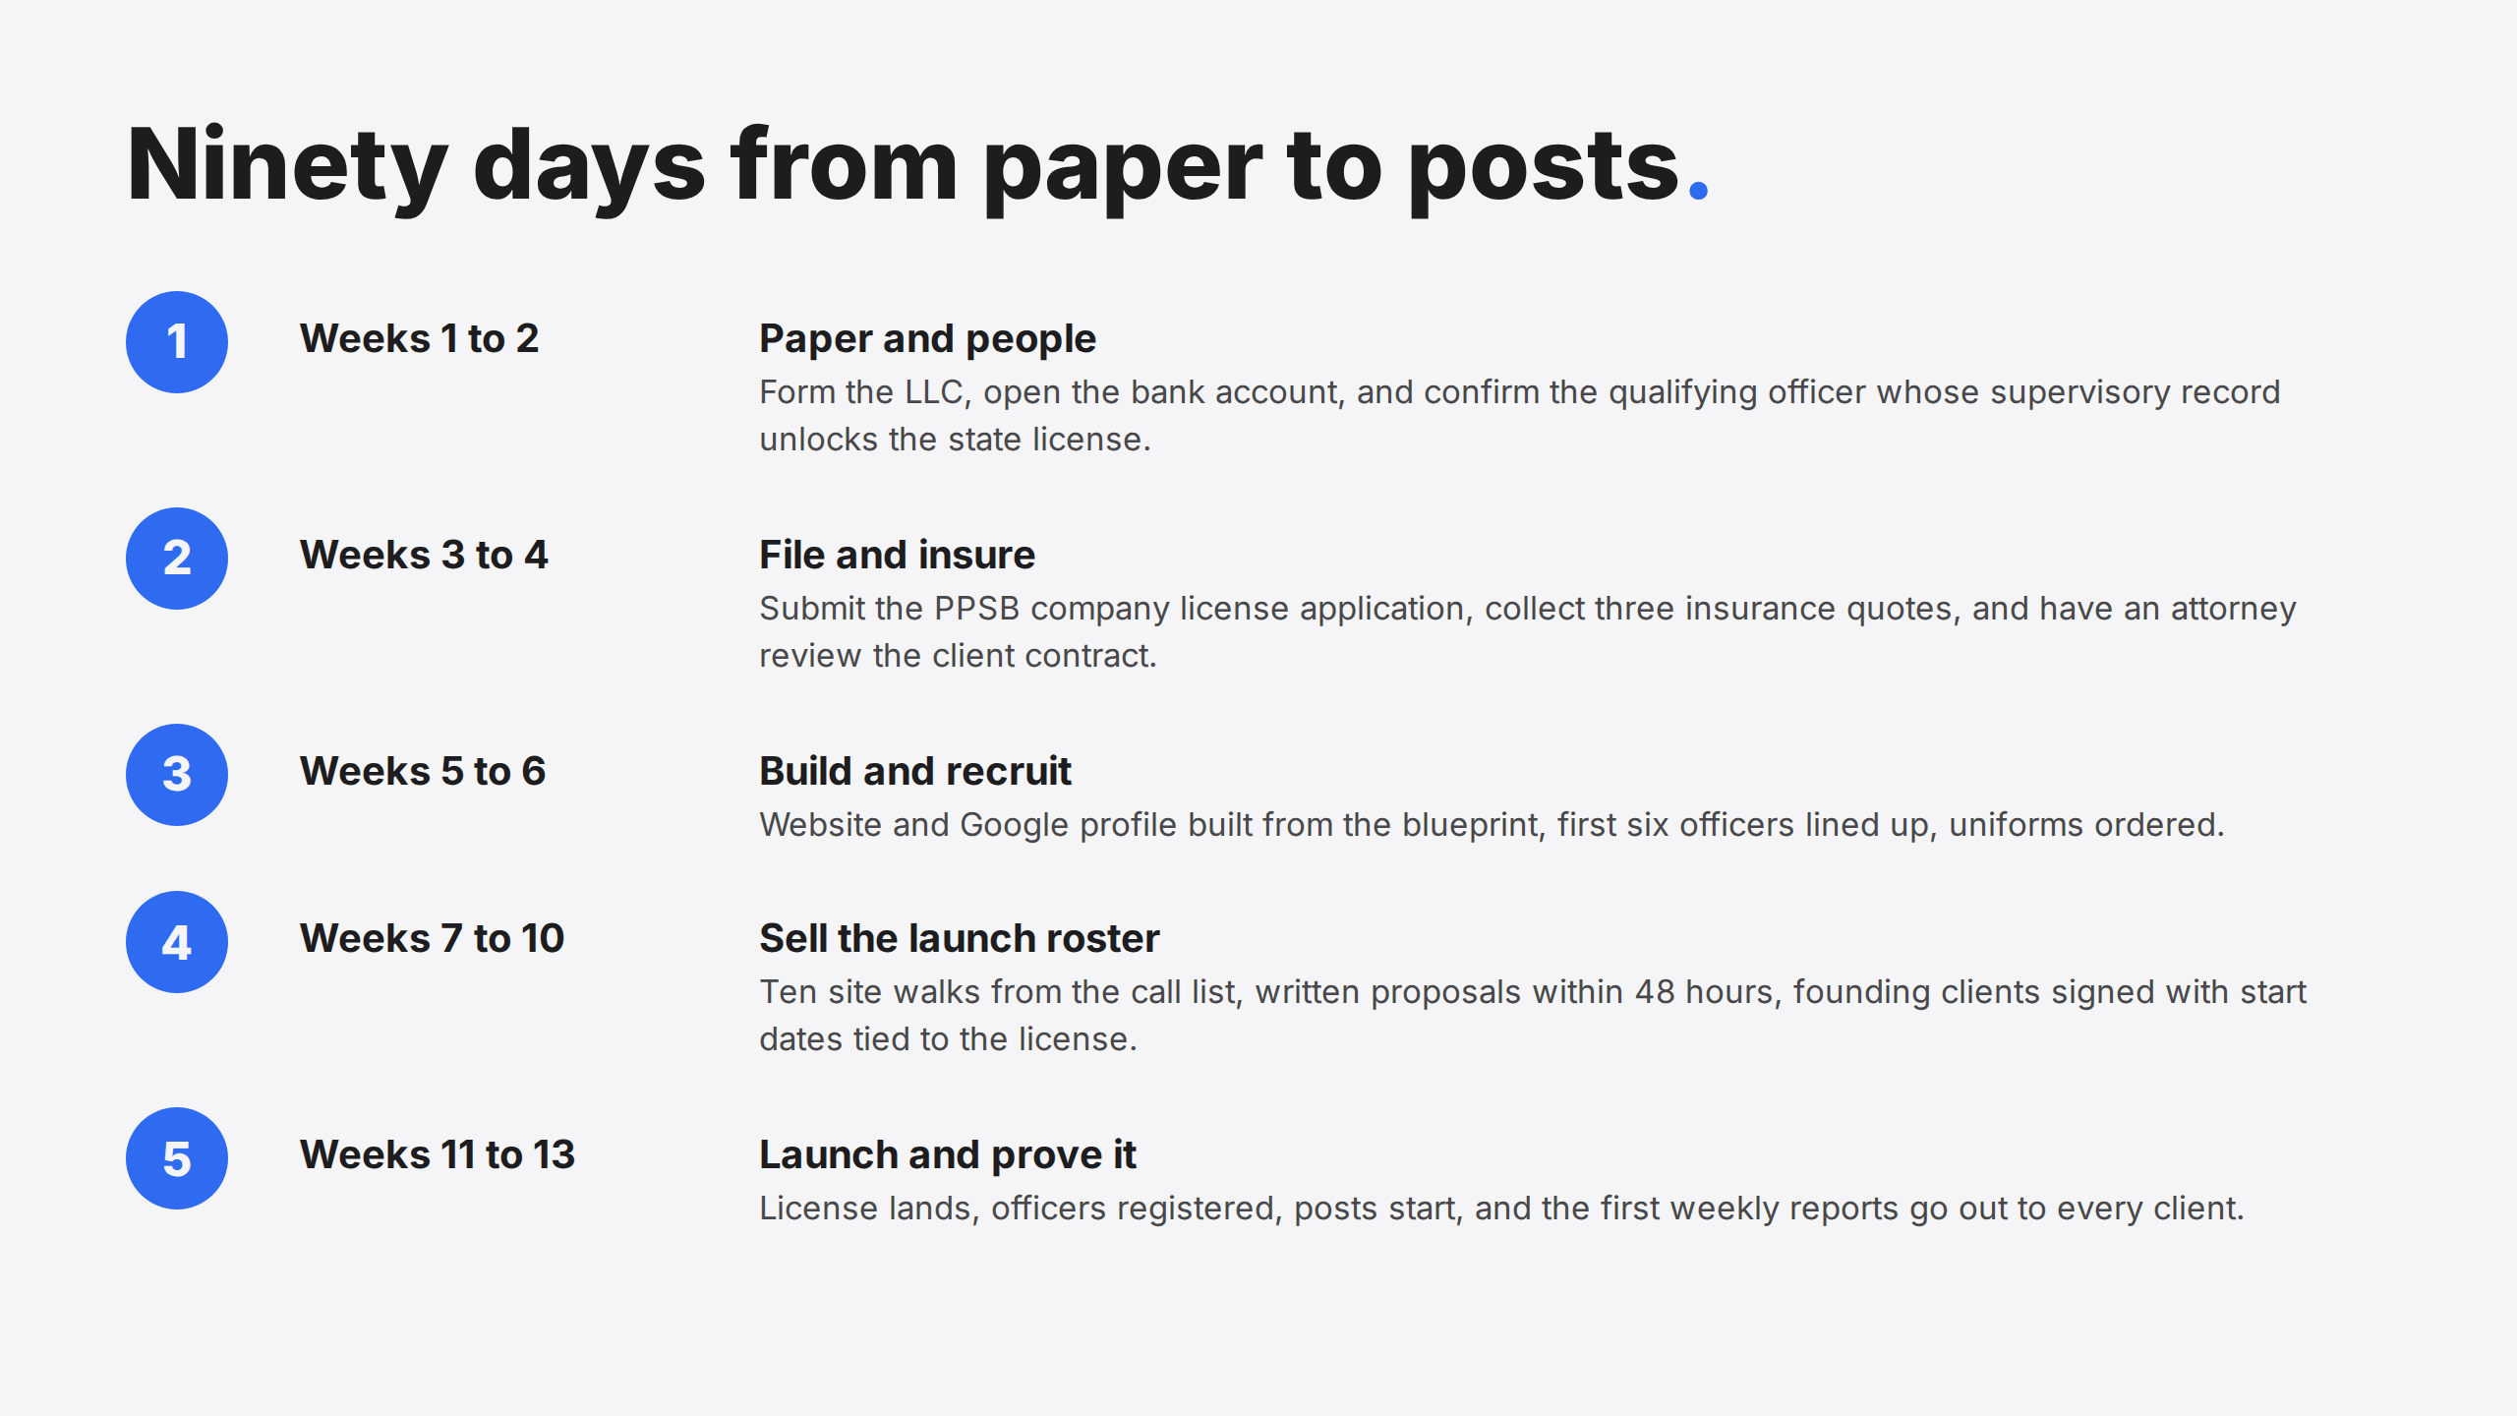
Notes:
Ninety days from paper to posts.

Slide 9
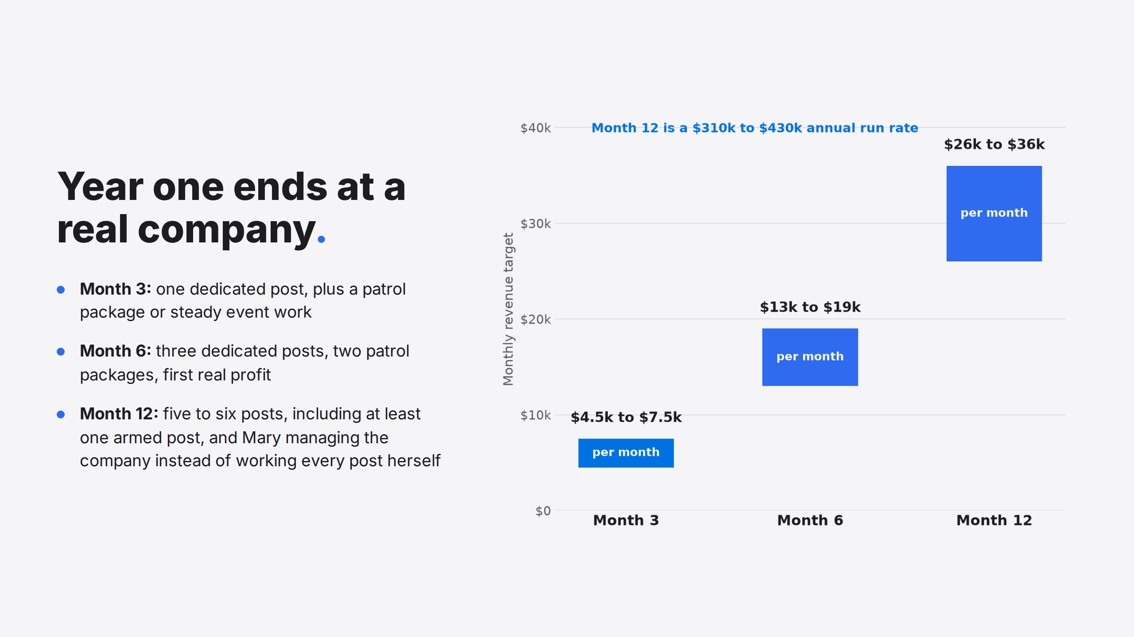
Notes:
Year one ends at a real company.

Slide 10


